Slide 1
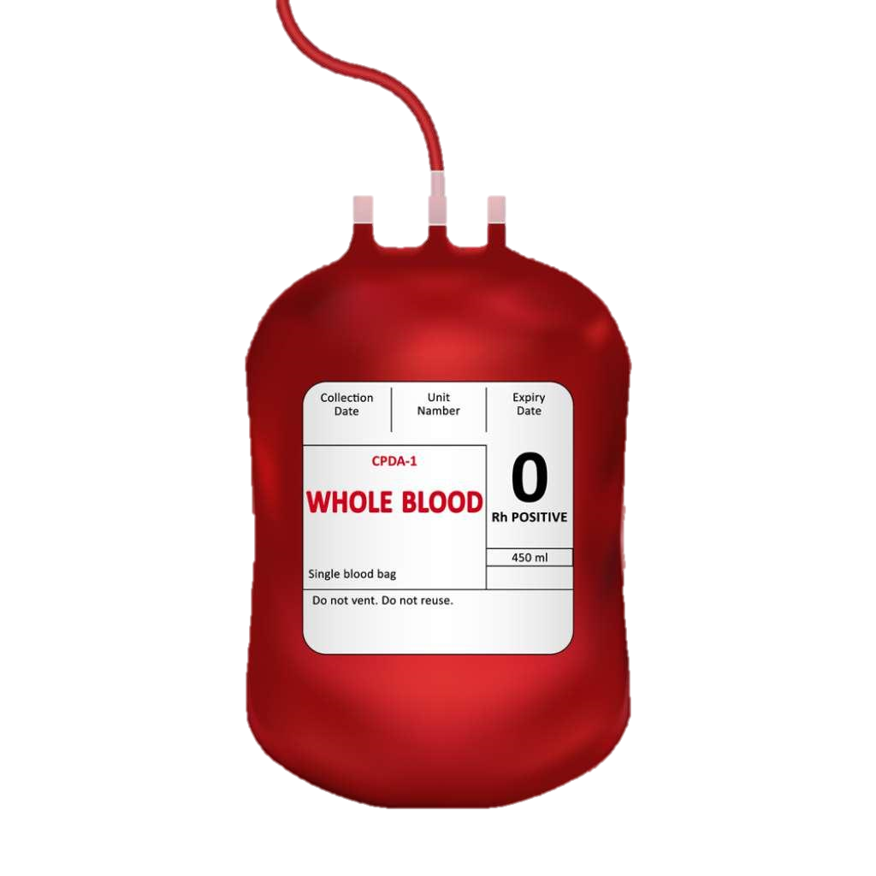
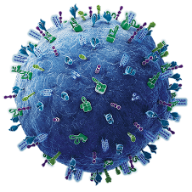




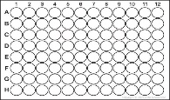




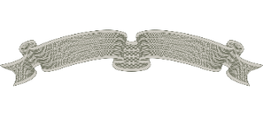
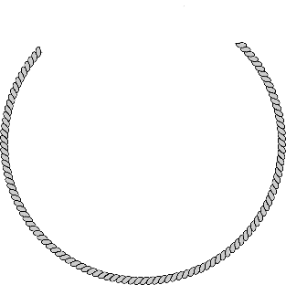
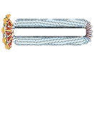
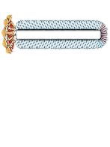
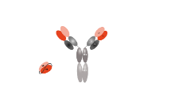
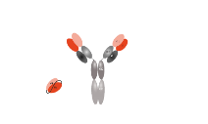
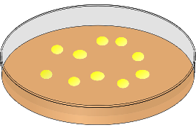


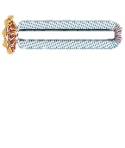
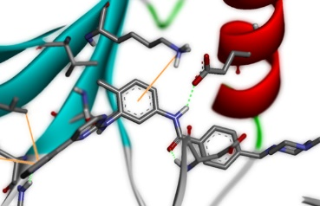

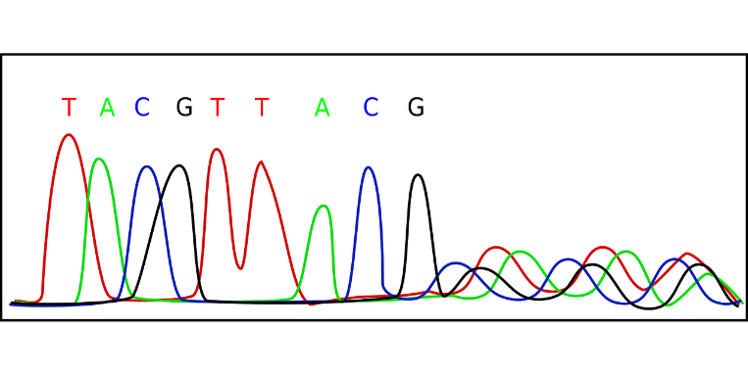

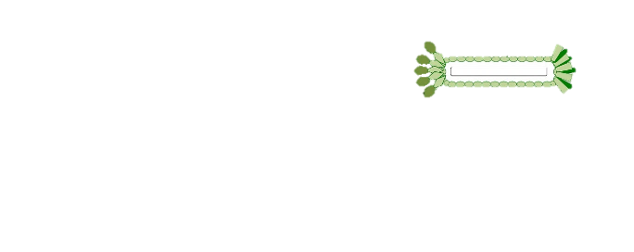
Blood Separation
PBMCs Culture
Antibody Pre-screening
CDNA Construction
PCR Amplification
of Variable Region
Hyperphage Infection & Packaging
Collection & Tittering
ELISA & Biopanning
Eluted Phages Enrichment
Colonies Collection
Library Input
Biopanning
(4-5 Rounds)
Application
ScFv Library
Positive Clones Output
Sequence Optimization
Sequencing Analyses
Fig. 1 Diagram of the specific target-binding scFv library construction and selection.

Slide 3
A
B
F: 2F-2H+Yol
F: 2A/2B/2C
V
D
J
Cμ1
Hinge
Cμ2
Cμ3
Cμ4
V
J
Cκ
(T)_{n}
(T)_{n}
IgM Heavy Chain cDNA
Kappa Light Chain cDNA
R: 2P
R: 2E+Yol
F: 2I+Yol/2K-2O+Yol
F: 2A/2B/2C
V
D
J
Cγ1
Hinge
Cγ2
Cγ3
V
J
Cλ
(T)_{n}
(T)_{n}
IgG Heavy Chain cDNA
R: 2Q
Lambda Light Chain cDNA
R: 2D+Yol
Extension PCR Amplification
VH
CH
Linker Sequence (Yol)
Linker Sequence (Yol)
VL
CL
NcoI
NotI
Variable Heavy Chain with Linker Sequence & NcoI site
Variable Light Chain with Linker Sequence & NotI site
Fig. 3 PCR strategy for amplification of human antibody sequences.

Slide 4
A
Overlapped Region (13nt)
VL
CL
5’-A GGT GAA TTT TCA GAA GC A CGC GT
│ │ │ │ │ │ │ │ │ │ │ │ │
TTC GAA CTT CTT CCA CTT AAA AGT-5’
HindIII
V
J
NotI
MluI
NcoI
V
D
J
VH
CH
Linker Sequence (Yol-tag)
B
AAG CTT GAA GAA GGT GAA TTT TCA GAA GC A CGC GT
│ │ │ │ │ │ │ │ │ │ │ │ │ │ │ │ │ │ │ │ │ │ │ │ │ │ │ │ │ │ │ │ │ │ │
TTC GAA CTT CTT CCA CTT AAA AGT CTT CG T GCG CA
NcoI
V
D
J
V
J
NotI
NcoI
V
D
J
V
J
NotI
C
Flanking primers, Pol., buffer
Forward flanking primer
AAG CTT GAA GAA GGT GAA TTT TCA GAA GC A CGC GT
│ │ │ │ │ │ │ │ │ │ │ │ │ │ │ │ │ │ │ │ │ │ │ │ │ │ │ │ │ │ │ │ │ │ │
TTC GAA CTT CTT CCA CTT AAA AGT CTT CG T GCG CA
NcoI
V
D
J
V
J
NotI
NcoI
V
D
J
V
J
NotI
Reverse flanking primer
Fig. 4 Detailed diagram of Overlap Extension PCR (OE-PCR) for scFv construction. (A) Annealing step in overlap PCR (B) Extension step in overlap PCR (C) Purification PCR

Slide 5
Set 1 PCR primers
55 °C
Set 2 PCR primers
57 °C
Primers w/ linker seq.
M
M
55 °C
58.1 °C
61.9 °C
65°C
VH
VL
VH
VL
VH
VL
VH
VL
VH
VL
VH
VL
1000 bp
500 bp
Fig. 5 Extension PCR using different set of primers, and the primers with linker sequence were tested at gradient temperature. According to the sensitivity, VH was amplified at T_{a} = 55℃ and VL was amplified at T_{a} = 65℃ for the following experiments.
(T_{a} : annealing temperature; VH: variable heavy chain; VL: variable light chain)

Slide 6
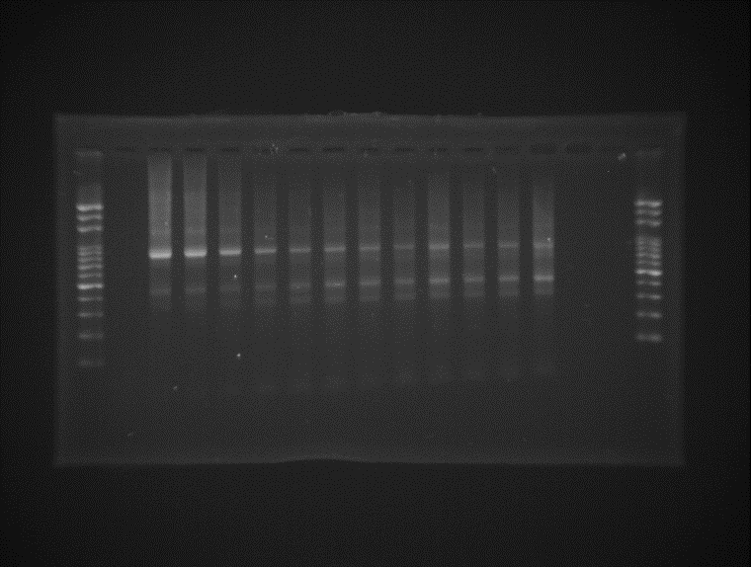
M
N
50.0 50.4 51.3 52.7 54.7 56.6 58.4 60.3 62.3 63.7 64.6 65.0
800 bp
scFv
400 bp
VH
VL
Fig. 6 Purification PCR at gradient T_{a} (annealing temperature)after 18 cycles of overlap PCR using 300ng of each gel-purified VH and VL. For following experiments, T_{a} was set as 50℃.
(M: marker; N: Negative control, VH & VL were replaced with ddH₂0; VH: variable heavy chain; VL: variable light chain; scFv: single-chained variable fragment)

Slide 7
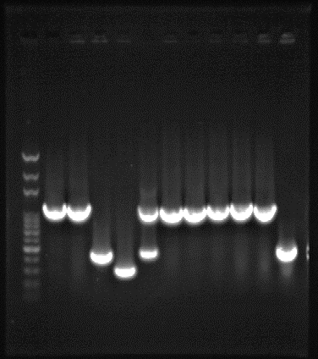
M
19
81
N
V: I = 1: 2
V: I = 1: 3
V: I = 1: 5
Fig. 7 Colony PCR was performed after electroporation, colonies were randomly picked to determine the integrity of inserts. Error rate were 1/8, 2/12, and 4/12, respectively. (M: marker; 81: 100ng of pSEX81 used in PCR; 19: 100ng of pUC19 used in PCR; N: plasmid is substituted with ddH₂O; V: vector; I: insert; the ratio indicated is the molar ratio)

Slide 8
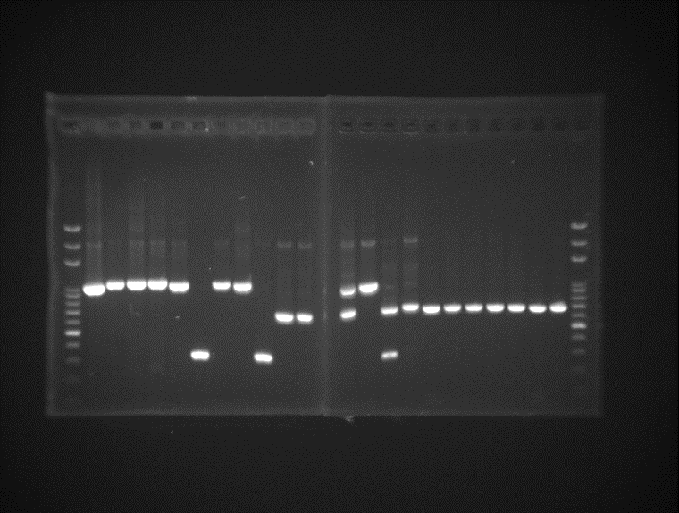
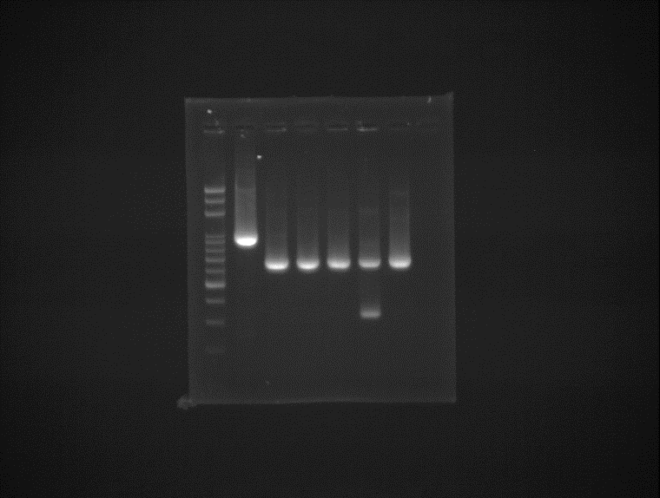
M
P
Heat shock
After Panning 1st
After Panning 2nd
After Panning 3rd
M
P
1000 bp
900 bp
800 bp
700 bp
600 bp
500 bp
Fig. 8 Colonies from each round in pool #2 of heat shock were randomly picked for PCR to confirm the integrity and diversity of the inserts. After two round of panning, one specific clone became dominating in this pool.
(M: marker; P: positive control, colony of XL-1 Blue with pSEX81 was picked)

Slide 9
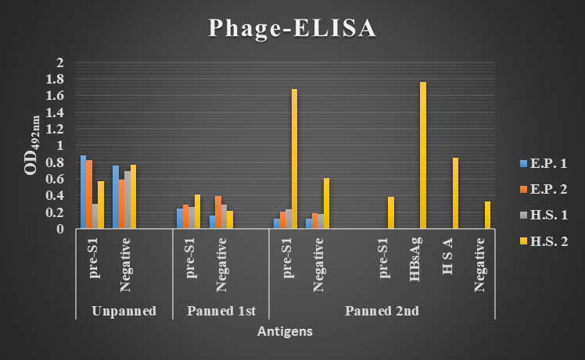
Fig. 9 Phage ELISA of each round of panning. After two rounds of panning, OD_{492nm} of H.S.2 was significantly increased. And other antigen were also tested in another round of ELISA to determine the specificity.(E.P. 1: pool #1 of electroporation; E.P. 2: pool #2 of electroporation; H.S. 1: pool #1 of heat shock; H.S. 2: pool #2 of heat shock )

Slide 10
Fig. 10 OD_{492nm} ratio of single-clone phage ELISA. Clone 757 has the highest ratio of HBsAg/HSA, and clone 242 has the highest ratio of HBsAg/BSA and HBsAg/N. (HSA: 100 ng human serum albumin/well; BSA: 100 ng bovine serum albumin/well; N: negative, no protein coated)

Slide 11
10 20 30 40 50
82 (HS#2 Pan 2nd) GHGMDDWGQG TTVIVSSAST KGPKLEEGEF SEARVDIQMT QSPSSLSASV
242 (HS#2 Pan 3rd) GHGMDDWGQG TTVIVSSAST KGPKLEEGEF SEARVDIQMT QSPSSLSASV 2436 (HS#2 Pan 3rd) GHGMDDWGQG TTVIVSSAST KGPKLEEGEF SEARVDIQMT QSPSSLSASV
60 70 80 90 100
82 (HS#2 Pan 2 ^{nd}) GDRVTITCRA SQGIRNDLGW YQQKPGKAPK RLIYAASSLQ SGVPSRFSGS
242 (HS#2 Pan 3 ^{rd}) GDRVTITCRA SQGIRNDLGW YQQKPGKAPK RLIYAASSLQ SGVPSRFSGS 2436 (HS#2 Pan 3 ^{rd}) GDRVTITCRA SQGIRNDLGW YQQKPGKAPK RLIYAASSLQ SGVPSRFSGS
110 120 130 140 154 82 (HS#2 Pan 2 ^{nd}) GSGTEFTLTI SSLQPEDFAT YYCLQYNNYP WTFGQGTKVE IKRTVAAPSVFAAA
242 (HS#2 Pan 3 ^{rd}) GSGTEFTLTI SSLQPEDFAT YYCLQYNNYP WTFGQGTKVE IKRTVAAPSVFAAA
2436 (HS#2 Pan 3 ^{rd}) GSGTEFTLTI SSLQPEDFAT YYCLQYNNYP WTFGQGTKVE IKRTVAAPSVFAAA
NcoI
Uncompleted VH
IgG
Linker
36---------LFR1----------
-----LFR1-----61
CDR1
68---------LFR2---------83
CDR2
87-------LFR3-------
----------------LFR3-----------------123
VL-CDR3
------LFR4----144
CLκ
NotI
Fig. 11 Sequences of positive clones from 2nd and 3rd round of panning were sequenced. Framework regions and CDRs were analyzed by using AbYsis.

Slide 12
4-----------------HFR1-----------------28
37--------HFR2-----------53
64-------
10 20 30 40 50 60 70
5225 scFv GHGGGAAVGV WGGLVQPGWS LRLSCTTSGF TFGDYAMSWV RQAPGKGLEW VGFIRSKLYG GTTEYAASVK
757 scFv GHGGGAAVGV WGGLVQPGWS LRLSCTTSGF TFGDYAMSWV RQAPGKGLEW VGFIRSKLYG GTTEYAASVK
80 90 100 110 120 130 140
5225 scFv GRFTISRDDS KSIAYLQMDS LKTEDTAVYY CSRDRGGDGM DVWGQGTTVT VSSGSASAPK LEEGEFSEAR
757 scFv GRFTISRDDS KSIAYLQMDS LKTEDTAVYY CSRDRGGDGM DVWGQGTTVT VSSGSASAPK LEEGEFSEAR
150 160 170 180 190 200 210
5225 scFv VSELTQPASA SGTPGQRVTI SCSGSSSNIG SNTVNWYQQL PGTAPKLLIY SNNQRPSGVP DRFSGSKSGT
757 scFv VSELTQPASA SGTPGQRVTI SCSGSSSNIG SNTVNWYQQL PGTAPKLLIY SNNQRPSGVP DRFSGSKSGT
220 230 240 250 260 269
5225 scFv SASLAISGLQ SEDEADYYCA AWDDSLNGWV FGGGTKLTVL –QPK-APSVT LFPPSSAAA
757 scFv SASLAISGLQ SEDEADYYCA AWDDSLNGWV FGGGTKLTVL GQPKAAPSVT LFPPSSAAA
NcoI
CDR1
CDR2
----------------------------------HFR3--------------------------101
CDR3
113-HFR4-123
IgM
Linker
141-------------LFR1-------------------164
CDR1
176--------LFR2------190
CDR2
194---------LFR3-----------
-------------LFR3------------229
CDR3
241----LFR4-----253
CLλ
NotI
Fig. 12 Sequences of full-length positive clone from 3rd round of panning were sequenced. And clone 5225 lacks 2 aa at position 251 and 255.

Slide 13
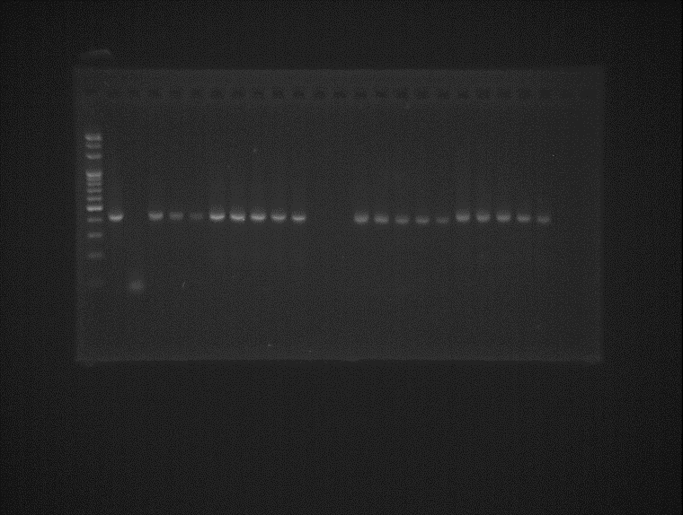
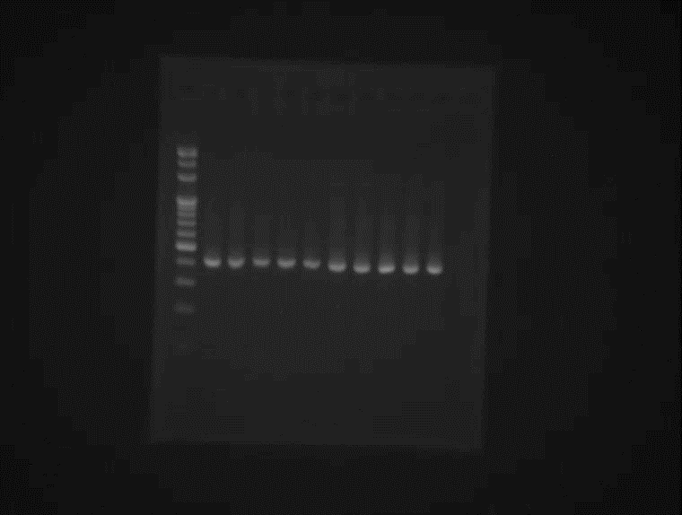
Fig. 13 Extension PCR using independent primer pairs to amplify pre-S1 VH & VL genes. (Each alphabetic code represented meanings were describe in Table 1; VH: variable heavy chain; VL: variable light chain)

Slide 14
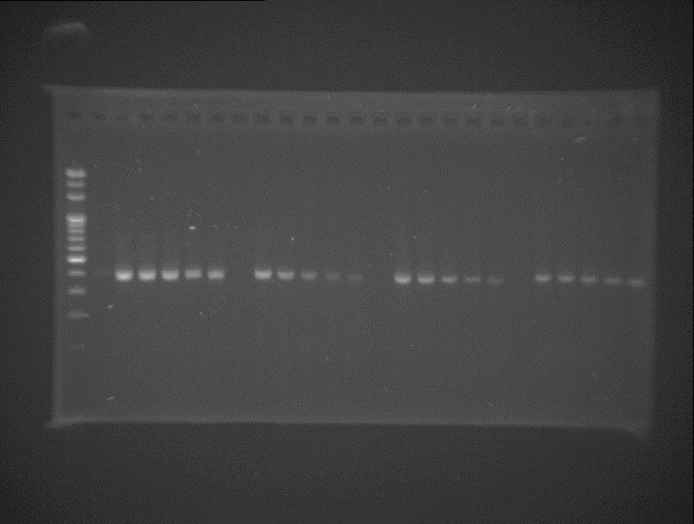
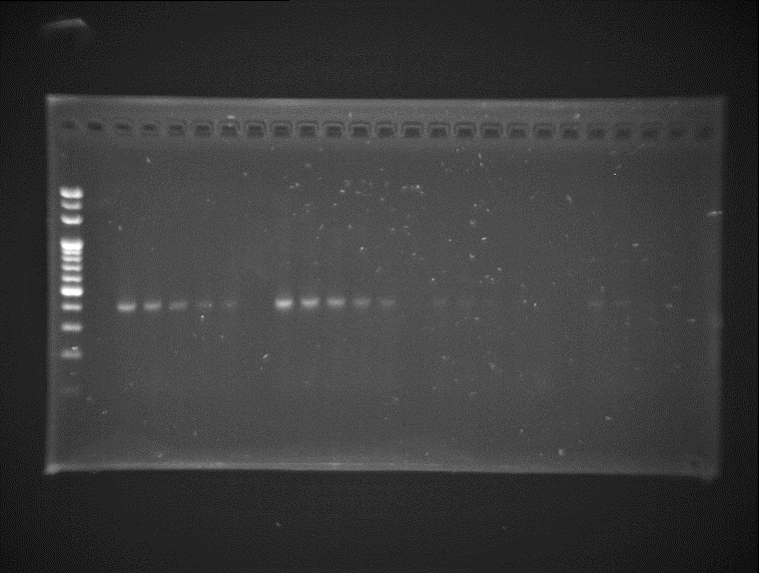
Fig. 14 Extension PCR using independent primer pairs to amplify HBsAg VH & VL genes. (Each alphabetic code represented meanings were describe in Table 1; VH: variable heavy chain; VL: variable light chain)

Slide 15
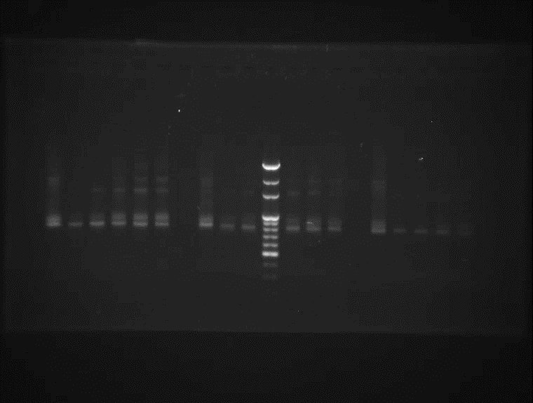
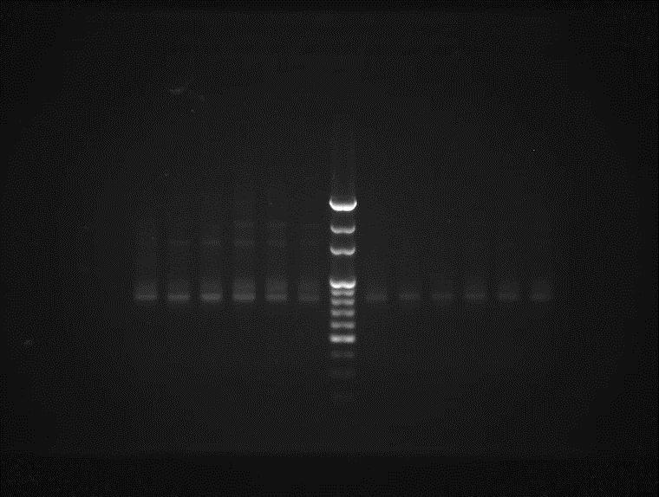
Fig. 15 Overlap/Purification PCR using 100ng of each gel-purified pre-S1/HBsAg VH & VL at gradient annealing temperature with different GC enhancer percentage.
(M: marker; N: Negative control, VH & VL were replaced with ddH₂0; VH: variable heavy chain; VL: variable light chain; scFv: single-chained variable fragment)

Slide 16
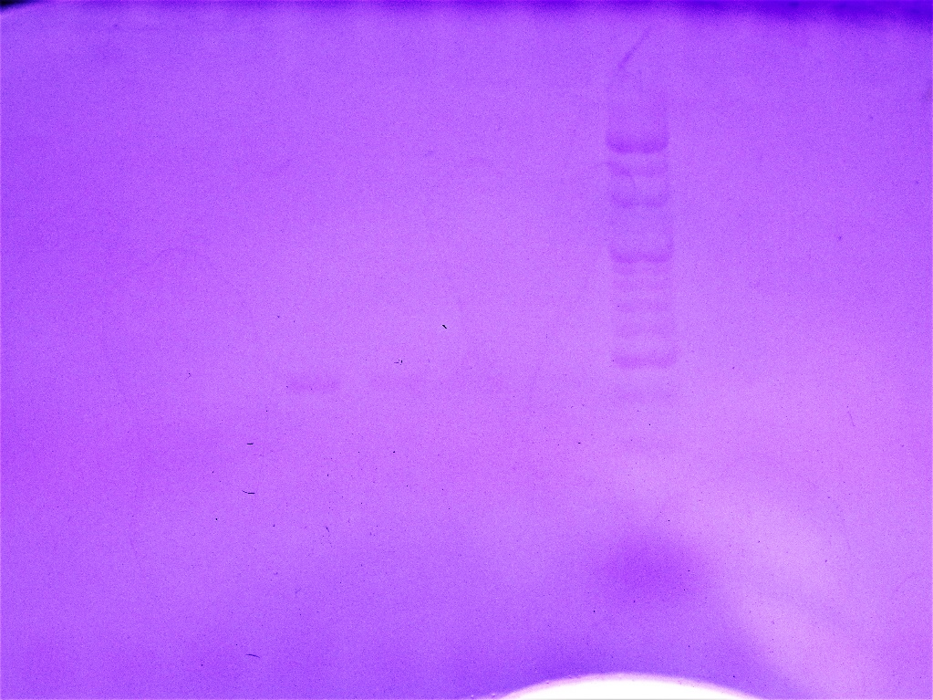
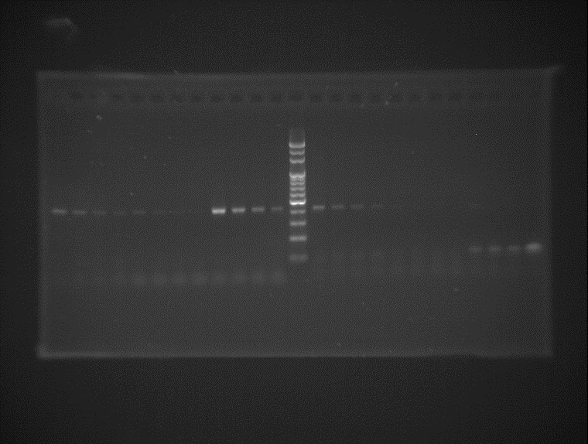
1000 bp
1000 bp
900 bp
900 bp
800 bp
800 bp
700 bp
700 bp
600 bp
600 bp
500 bp
500 bp
400 bp
400 bp
Fig.16 PCR products were electropherosed on 1.2% CV/OG agarose gel, and the same gel is stained with SYBR Safe and visualized under 302 nm UV light.

Slide 17
A
B
C
D
Fig. 17 OD_{492nm} ratio at each round of phage ELISA of (A)pool 1,pre-S1 scFv (B)pool 2, HBsAg scFv (C)pool 3, HBsAg scFv w/ α-HBsAg-VL (D)pool 4, HBsAg-VH + α-HBsAg-VL plasmid . (HSA: 100 ng human serum albumin/well; BSA: 100 ng bovine serum albumin/well; N: negative, no protein coated)

Slide 18
NcoI
4-----------------HFR1-----------------28
CDR1
37--------HFR2-----------53
CDR2
62-------
1-4 GHG------- ---------- ---------- ---------- ---------- ---------- ---------- 3
1-5 GHGGGAAVES GGGLVQPGGS LRLSCAASRF TFSSYWMHWV RQAPGKGLVW VSRVNSDGSS TSYADSVKGR 70
1-17 GHGGGAAVES GGGVVRPGGS LRLSCTTSGF TFDDHGMSWV RQAPGKGLEW VSGINWNGGN TGYADSVKGR 70
1-4 ---------- ---------- ---------- ---------- ---------- TLVTVSSAST KGPKLEEGEF 23
1-5 FTISRDNAKN TLYLQMNSLR AEDTAVYYCA RDLL------ PWGLLNWGQG TLVAVSSAST KGPKLEEGEF 134
1-17 FTISRDNAMN SLFMQMNSLT DEGTALYYCA RHARSSDWGS GYGIDVWGQG TAVTVSSAST KGPKLEEGEF 140
1-4 SEARVDIQMT QSPSSLSASV GDRVTITCQA SQD--IRKYL NWYQQKPGKA PKLLIYDVSN LETGVPSRFS 91
1-5 SEARVDIEMT QSPSTLSASV GDRVTITCRA SQS--ISSWL AWYQQKPGEA PKLLIYKASS LESGVPSRFS 202
1-17 SEARVNFMLT QPPS-ASGTP GQRVTISCSG SSSNIGSNTV NWYQQLPGTA PKLLIYSNNQ RPSGVPDRFS 209
1-4 GSGSGTDFTF TISSLQPEDI ATYYCQQYDH FSV-FGGGTK --VEVRRTVA APSVF----- -AAA 146
1-5 GSGSGTEFTL TISSLQPDDF ATYYCQQYNS YPWTFGQGTK --VEIKRTVA APSV------ -SRP 258
1-17 GSKSGTSASL AISGLQSEDE LIITVQHGMT A*MVGCSAEG PS*PSOSAQA APSVTLFPPS SAAA 271
------------------------------HFR3----------------------99
CDR3
-------HFR4-------
IgG
Linker
Linker
------------------LFR1------------------------
CDR1
-------------LFR2-----------
CDR2
------LFR3--------
---------------------LFR3-----------------------
CDR3
---------LFR4-----------
CLκ/CLλ
NotI
Fig. 18 Sequences of positive clones from pool 1 after 4th round of panning were sequenced. One kappa light chain and 2 scFv were identified.

Slide 19
NcoI
4-----------------HFR1-----------------28
CDR1
37--------HFR2-----------53
CDR2
62--------------
2-30 GHGAGAAEQS GGGLVQPGGP LRLSCAASGF TFSNYWLSWV RQAPGKGLEW VANIKLDGSE TYYVDSVKGR 70
2-20 GHGAGELVQS GGGLVQPGGS LRLSCADSGF TFSNYWLSWV RQAPGKGLEW VANIKLDGSE TYYVDSVKGR 70
2-30 FTISRDNAKD SLYLQMNSLR AEDTAVYYCA RVNYAEFPHW GQGTLVTVSS GSASAPKLEE GEFSEARVNF 140
2-20 FTISRDNAKD SLYLQMNSLR AEDTAVYYCA RVNYAEFPHW GQGTLVTVSS GSASAPKLEE GEFSEARVNF 140
2-30 MLTQPPSASG SPGQSVTISC TGTSSDVGGY NYVSWYQQHP GKAPKLMIYE VSKRPSGVPD RFSGSKSGNT 210
2-20 MLTQPPSVSK DLRQTATLTC TGNSNIVG-N QGAAWLRQRQ GHPPKLLSYR NNNRPSGISE RFSASRSGNT 209
2-30 ASLTVSGLQA EDEADYYCSS YAAATIGCSA EGPS*PS*SA QGCPLGHSVP AVL-----CGR 264
2-20 ASLTITGLQP EDEADYYFSS LDSSLSALKQ MFGGGTKLT- -VLVSPKLPP RSLCSRRPLRP 267
-------------------------------HFR3-----------------------99
CDR3
110-HFR4-120
IgM
Linker
138-
---------------LFR1-------------------163
CDR1
173--------LFR2--------189
CDR2
193-----------LFR3-----------
------------LFR3-----------228
CDR3
-LFR4-
CLλ
NotI
Fig. 19 Sequences of positive clones from pool 2 after 4th round of panning were sequenced.
Two full-length scFv were identified.

Slide 20
10 20 30 40 50 60 70
4-6 GHGAGAAGAV WGRLGQPGGP LRLSCAASGF TFSNYWLSWV RQAPGKGLEW VANIKLDGSE TYYVDSVKGR
4-42 GHGAGAAGAV WGGLVQPGGS LRLSCAASGF TFSNYWLSWV RQAPGKGLEW VANIKLDGSE TYYVDSVKGR
80 90 100 110 120 130 140
4-6 FTISRDNAKD SLYLQMNSLR AEDTAVYYCA RVNYAEFPHW GQGTLVTVSS GSASAPKLEE GEFSEARVDI
4-42 FTISRDNAKD SLYLQMNSLR AEDTAVYYCA RVDYAEFPHW GQGTLVTVSS GSASAPKLEE GEFSEARVDI
150 160 170 180 190 200 210
4-6 QMTQSPSSLS ASVGDRVTIT CRASQGIRND LGWYQQKPGK APKRLIYAAS SLQSGVPSRF SGSGSGTEFT
4-42 QMTQSPSSLS ASVGDRVTIT CRASQGIRND LGWYQQKPGK APKRLIYAAS SLQSGVPSRF SGSGSGTEFT
220 230 240 250 257
4-6 LTISSLQPED FATYYCLQYN NYPWTFGQRD QSGNQTNCGC TICLRGR
4-42 LTISSLQPED FATYYCLQYN NYPWTFGQRD QSGNQTNCGC TICLRGR
NcoI
4-----------------HFR1-----------------28
CDR1
37--------HFR2-----------53
CDR2
62-------------
------------------------------HFR3-------------------------99
CDR3
109-HFR4-120
IgM
Linker
138-
------------------LFR1-------------------164
CDR1
171--------LFR2------187
CDR2
191-------------LFR3--------------
-----------LFR3---------226
CDR3
236--LFR4--246
CLκ
NotI
Fig. 20 Sequences of positive clones from pool 4 after 4th round of panning were sequenced.
Two full-length scFv were identified, light chain is the same one in figure 10 .

Slide 21
Table. 1 Primers with linker sequences used for variable region amplification.
 | Sequence
Heavy chain variable primer 2A (2VH1) | 5’- GAA TAG GCC ATG GCG SAG GTG CAG CTG GTG CAG TCT-3’
Heavy chain variable primer 2B (2VH2) | 5’- GAA TAG GCC ATG GCG CAG GTR CAG CTG CAG SAG TC-3’
Heavy chain variable primer 2C (2VH3) | 5’- GAA TAG GCC ATG GCG GAG GTG CAG CTG KTG GAG TCT-3’
Heavy chain constant primer 2D (2IgG)+ Yol | 5’- TGA AAA TTC ACC TTC TTC AAG CTT TGG GCC CTT GGT GGA-3’
Heavy chain constant primer 2E (2IgM)+Yol | 5’- TGA AAA TTC ACC TTC TTC AAG CTT TGG GGC GGA TGC ACT-3’
Light chain variable (kappa) primer 2F (2kappa 1/4)+Yol | 5’-AGG TGA ATT TTC AGA AGC ACG CGT AGA CAT CSW GAT GAC CCA GTC TCC-3’
Light chain variable (kappa) primer 2G (2 kappa 2)+Yol | 5’- AGG TGA ATT TTC AGA AGC ACG CGT AGA TAT TGT GAT GAC YCA GWC TCC A -3’
Light chain variable (kappa) primer 2H (2 kappa 3)+Yol | 5’- AGG TGA ATT TTC AGA AGC ACG CGT AGA AAT TGT RWT GAC RCA GTC TCC A-3’
Light chain variable (lambda) primer 2I (2 lambda 1)+Yol | 5’- AGG TGA ATT TTC AGA AGC ACG CGT ACA GTC TGT GYT GAC KCA GCC GCC CTC A-3’
Light chain variable (lambda) primer 2K (2 lambda 2/5)+Yol | 5’- AGG TGA ATT TTC AGA AGC ACG CGT ACA GTC TGC GCT GAC TCA RCC GSC CTC T-3’
Light chain variable (lambda) primer 2L (2 lambda 3)+Yol | 5’- AGG TGA ATT TTC AGA AGC ACG CGT ATC CTA TGA ACT GAC TCA GCC ACC YT-3’
Light chain variable (lambda) primer 2M (2 lambda 4a)+Yol | 5’- AGG TGA ATT TTC AGA AGC ACG CG T ATC TGA ACT GAC TCA GCC DSC CTC-3’
Light chain variable (lambda) primer 2N (2 lambda 4b)+Yol | 5’- AGG TGA ATT TTC AGA AGC ACG CGT ATC TGA ACT GAC TCA GGA CCC TGY T-3’
Light chain variable (lambda) primer 2O (2 lambda 6)+Yol | 5’- AGG TGA ATT TTC AGA AGC ACG CGT ARA TTT TAT GCT GAC TCA GCC CCC CTC T-3’
Light chain constant (kappa) primer 2P (2 kappa C) | 5’-TGA CAA GCT TGC GGC CGC GAA GAC AGA TGG TGC AGC CAC AGT-3’
Light chain constant (lambda) primer 2Q (2 lambda C) | 5’- TGA CAA GCT TGC GGC CGC AGA GGA SGG YGG GAA CAG AGT GAC-3’

Slide 22
Table. 2 Details for each variable region amplification by one pair of primers.
Primer pair |  | Pre-S1 |  |  | HBsAg
 |  | Program | Polymerase | Additives | Program | Polymerase | Additives
Heavy Chain | 2A/2D+Yol | Touchdown, T_{a} = 52℃ | OneTaq | No | 94℃ for 5 mins, 30 cycles of 94℃ for 45 secs, 50℃ for 1 min, and 68℃ for 1 min, and finally 68℃ for 5 min | OneTaq | 10% GC Enhancer
 | 2A/2E+Yol | Touchdown PCR (-1℃/ cycle, for first 10 cycles; T_{a} = 57℃, for another 20 cycle)
 | 2B/2D+Yol |  |  |  |  | Q5 | 20% GC Enhancer
 | 2B/2E+Yol
 | 2C/2D+Yol |  |  |  |  |  | 5% GC E.
 | 2C/2E+Yol |  |  |  |  | OneTaq | No
Light Chain | 2F+Yol/2P | Touchdown, T_{a} = 52℃ |  |  |  | OneTaq | 10% GC Enhancer
 | 2G+Yol/2P
 | 2H+Yol/2P
 | 2I+Yol/2Q | 94℃ for 5 mins, 30 cycles of 94℃ for 45 secs, 50℃ for 1 min, and 68℃ for 1 min, and finally 68℃ for 5 min
 | 2K+Yol/2Q
 | 2L+Yol/2Q
 | 2M+Yol/2Q |  |  | 10% GC E. |  |  | No
 | 2N+Yol/2Q |  | Master Mix | No |  | Q5 | No
 | 2O+Yol/2Q |  | OneTaq | No |  | Q5 | No

Slide 23
Table. 3 Details of four rounds biopanning including target peptide concentration, blocking buffers, Tween 20 percentage, washing numbers and incubation time of phage. (Adopted from Rahbarnia L, et al. (2016) )
Round | I | II | III | IV
Target peptide(ng/well) | 100 | 100 | 100 | 100
Blocking buffers | 2% MPBS | 3% MPBS | 2% MPBS | 3% MPBS
Tween 20 percentage | 0.1% | 0.1% | 0.15% | 0.2%
Washing numbers | 3 | 5 | 10 | 10
Incubation time of phages (hrs) | 2 | 1.5 | 1 | 1

Slide 24
Table. 4 Characteristics of each positive clone, which were analyzed by IgBlast.
 | Heavy chain |  |  | Light Chain
 | V chain | D chain | J chain | V chain | J chain
1-5 | IGHV3-74*01 (98%) | IGHD2-21*02 (80%) | IGHJ4*02 (97.1%) | IGKV1-5*03 (98.6%) | IGKJ1*01 (94.9%)
1-17 | IGHV3-20*01 (95.2%) IGHV3-20*03 (95.2%) | IGHD6-19*01 (92.3%) | IGHJ6*02 (95.8%) | IGLV1-44*01 (99.7%) | IGLJ3*02 (100%)
α-pre-S1 VL |  |  |  | IGKV1-33*01 (96.8%) | IGKJ4*01 (96.6%)
2-20 | IGHV3-7*03 (95.2%) | IGHD1-7*01 (100%) | IGHJ1*01 (95.2%) | IGLV10-54*02 (97.9%) | IGLJ3*02(100%)
2-30 | IGHV3-7*03 (95.2%) | IGHD1-7*01 (100%) | IGHJ1*01 (95.2%) | IGLV2-8*01 (99.3%) | IGLJ3*02(100%)
4-6 | IGHV3-7*03 (95.2%) | IGHD1-7*01 (100%) | IGHJ1*01 (95.2%) | IGKV1-17*01 (97.9%) | IGKJ1*01 (100%)
4-42 | IGHV3-7*03 (96.6%) | IGHD4-17*01 (100%) | IGHJ1*01 (95.3%) | IGKV1-17*01 (97.9%) | IGKJ1*01 (100%)
525/7557 | IGHV3-49*04 (95.4%) | IGHD5-24*01 (100%) | IGHJ6*02 (82.9%) | IGLV1-50*01 (64.8%) | IGLJ3*02 (87.5%)
α-HBsAg VL |  |  |  | IGKV1-17*01 (97.9%) | IGKJ1*01 (100%)

Slide 25
Table. 5 Complemantarity-determining regions (CDR) of each positive clone, which were analyzed by IMGT.
 | Heavy chain |  |  | Light Chain
 | CDR1 | CDR2 | CDR3 | CDR1 | CDR2 | CDR3
1-5 | RFTFSSYW | VNSDGSST | ARDLLPWGLLN | QSISSW | KAS | QQYNSYPWT
1-17 | GFTFDDHG | INWNGGNT | ARHARSSDWGSGYGIDV | SSNIGSNT | SNN | AAWDDSLNGWV
α-pre-S1 VL |  |  |  | QDIRKY | DVS | QQYDHFSV
2-20 | GFTFSNYW | IKLDGSET | ARVNYAEFPH | SNIVGNQG | RNN | SSLDSSLSALKQM
2-30 | GFTFSNYW | IKLDGSET | ARVNYAEFPH | SSDVGGYNY | EVS | SSYAGSNNWV
4-6 | GFTFSNYW | IKLDGSET | ARVNYAEFPH | QGIRND | AAS | LQYNNYPWT
4-42 | GFTFSNYW | IKLDGSET | ARVNYAEFPH | QGIRND | AAS | LQYNNYPWT
525/7557 | GFTFGDYA | IRSKLYGGTT | SRDRGGDGMDV | SSNIGSNT | SNN | AAWDDSLNGWV
α-HBsAg VL |  |  |  | QGIRND | AAS | LQYNNYPWT

Slide 26
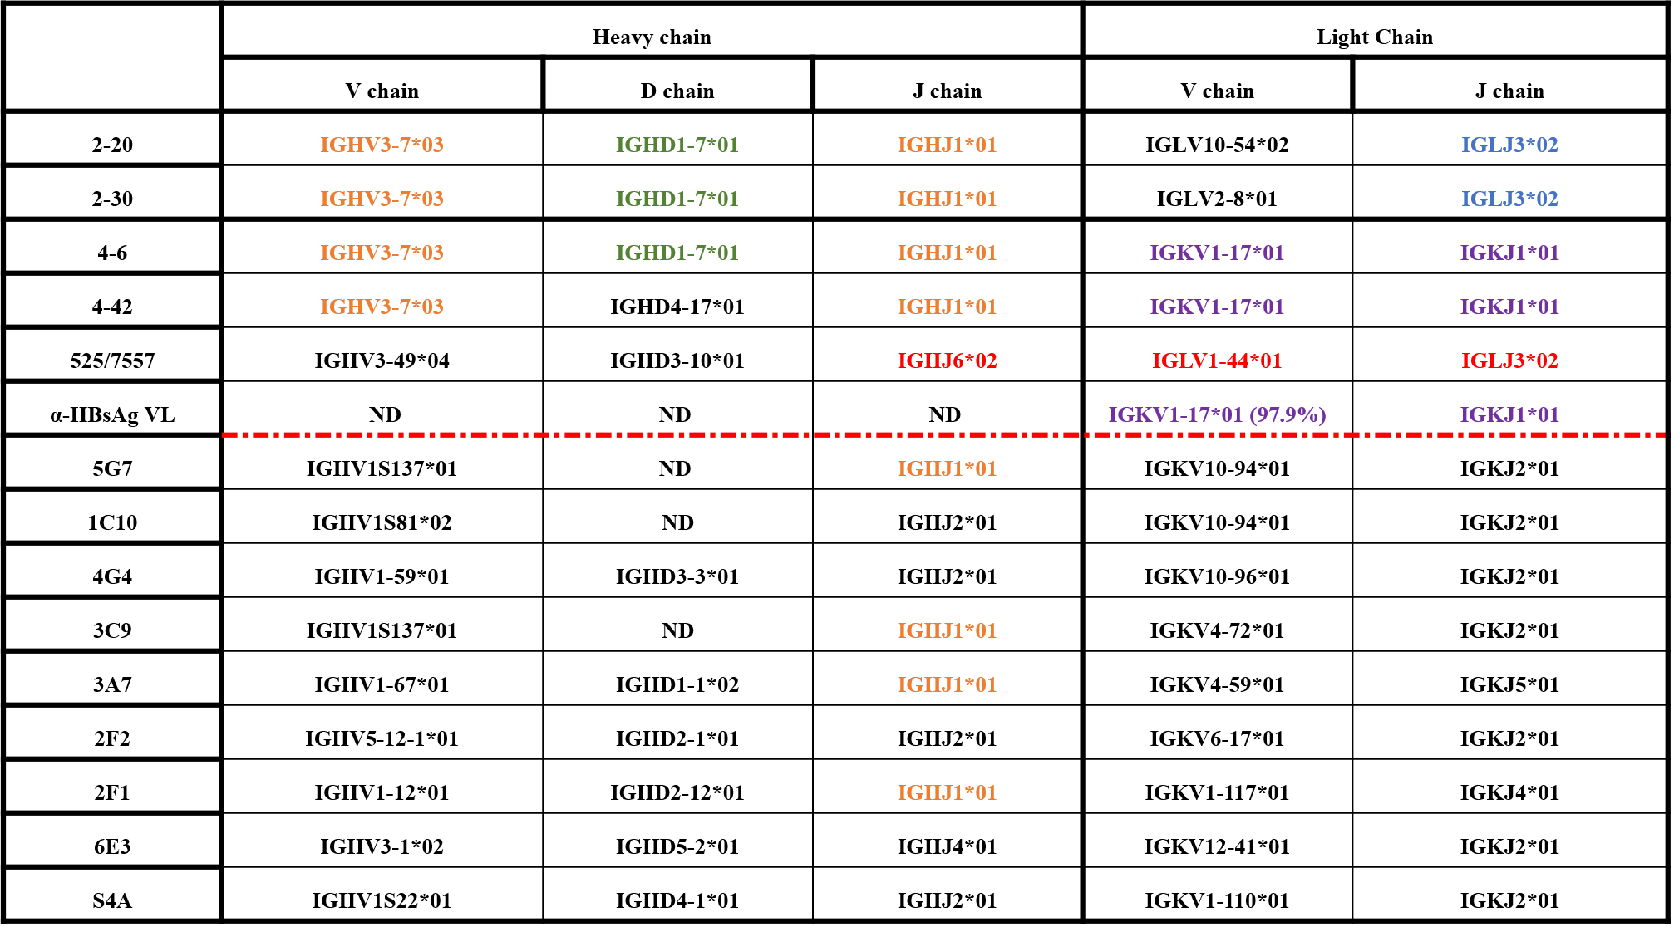
Table. 6 Characteristic comparison of current anti-HBsAg antibodies and our positive clones .

